Slide 1
Rainfall-Aware Landslide Risk Mapping for Himachal Pradesh
ASSIGNMENT 3
Interim progress: from a risk map to a daily landslide early-warning system for HP's disaster authorities (problem, methodology, implementation, results)
Suraj Raj (2026MCS2801) · Siddhesh Pohare (2026MCS2257)
M.Tech ICTD, IIT Delhi · Instructor: Prof. Aaditeshwar Seth · NGO mentor: Betwa Solutions
Notes:
Assignment 3. Same project and title as Presentations 1 (17 Aug) and 2 (17 Sep). The deck is meant to be read without a presenter. Each content slide has a section label, a title, a one-line message (the conclusion), the evidence, and a source line; these notes add detail and point to the project files holding the numbers.

Slide 2
The project at a glance
SUMMARY
We built and tested the core of a daily warning system; it separates storm days from quiet days, and we know its limits
Problem
What we built
Honest limits
Rain-triggered landslides block roads and kill people in Himachal Pradesh (HP) every monsoon
Published HP studies give static maps (where), not daily warnings (when)
Goal: a daily, district-level warning for HP's disaster authorities, using free data only
981 dated landslides (HP, Uttarakhand, J&K) with 42 features each
2,167 hard 'no-landslide' examples (training table: 3,136 rows)
A model tested honestly (whole years hidden) and a whole-HP daily scoring of 55,253 cells of 1 km
Catches about half of recorded HP slides at the lower alert level
Rain alone times slides as well as the model: the satellite rain data sets the ceiling
Records are biased to roads; remote areas are less certain
0.775
0.856
66.8%
0.4%
Live model skill (ROC AUC), whole years hidden; 0.5 = coin toss
Same model with the easy random-row test: why a high score can mislead
of HP flagged on a storm day (14 Aug 2023), all 31 recorded slides inside
of HP flagged on a quiet day (12 Sep 2023), 0 of 12 districts alerted
Next: daily automation and email alerts, storm replays to set the final alert rules, impact-assessment design, final paper.
Source: Our analysis of the landslide inventory (GSI Bhusanket, NASA Global Landslide Catalog) with NASA GPM IMERG rainfall; tests on slide 12; maps on slides 21–22.
Notes:
Summary of the whole deck. Skill: Random Forest, live data, whole years held out. Storm/quiet shares: road-neutral map with a model trained without 2023.

Slide 3
Where the project stood after Presentations 1 and 2
RECAP
We proposed rainfall-aware risk mapping, built a first dataset and model, and were told our negative examples were the weak point
Presentation 1 (17 Aug): proposal
Presentation 2 (17 Sep): first build
Feedback on Presentation 2
Idea: risk = terrain susceptibility × rainfall, for HP, delivered to disaster authorities (not the public)
AHP-weighted terrain map as a baseline
Research questions: RQ1 does rainfall improve on terrain alone; RQ2 new vs reactivated slides; RQ3 terrain–land-use–rain combinations
Feedback: AHP maps are common; rainfall-based prediction is under-explored but needs dated landslides; small road slides are too small for open satellite data
GSI's national inventory extracted from a 904-page PDF (36,071 records); only 1.7% of HP records have an exact date
Uttarakhand and J&K added by a two-stage method; 886 dated events
CHIRPS rainfall for 3–30 days before each event
First models on slope + rain with random background points: Random Forest AUC 0.895
'Good effort in assembling a dataset'
'Negative sampling has some serious issue': a slope-and-rain model gives high recall but low precision, so many false alarms and users stop trusting it
This feedback drove most of the work since (slides 5–6)
Source: Our Presentation 1 (17 Aug 2026) and Presentation 2 (17 Sep 2026) decks and the instructor's written feedback.
Notes:
Recap for a reader who does not remember the earlier presentations. Presentation 1 also included an AHP susceptibility baseline (Siddhesh: 6 factors, consistency ratio 0.0124; validated against Sentinel-2 change masks, global AUC 0.62).

Slide 4
Why Himachal Pradesh needs a daily landslide warning
PROBLEM
The data to warn exist every day for free; what is missing is a tested system that turns them into district alerts
The gap
Our goal and user
Monsoon rain triggers landslides across HP every year; in 2023 they caused hundreds of deaths and closed hundreds of roads
Published HP studies (Kullu valley, AUC 0.79–0.91; Beas basin, AUC 0.86) produce static maps: where, not when
GSI's regional landslide forecasting covered only Shimla and Kinnaur in HP as of the 2025 monsoon
Every morning, score landslide risk for every 1 km cell of HP
Give each of the 12 districts a level: no alert, Watch or Warning
Email the district and state disaster authorities; show the map in a web app
Built on free global data, so a partner organisation can run it
195
12 districts
55,253 cells
dated HP landslides (2005–2026) in our cleaned inventory
each to receive a daily level: none, Watch or Warning
of 1 km covering the whole state, scored every day
Source: Meena et al. 2019; Singh et al. 2024; Ministry of Earth Sciences, Lok Sabha reply 2025 (GSI coverage); 2023 toll: state figures in the press, Aug 2023.
Notes:
The 2023 monsoon caused hundreds of deaths in HP and closed hundreds of roads; press reports of state figures give different totals depending on the date (e.g. 257 deaths reported on 14 Aug 2023, 361 on 24 Aug 2023), so no single figure is claimed here.

Slide 5
What we changed since Presentation 2
RESPONSE TO FEEDBACK
Each point of feedback was investigated, measured and fixed, not just acknowledged
Feedback or issue | What we found when we checked | What we changed (Oct–Nov)
Negative sampling has a serious issue | Old negatives were random: median 3,868 m high (landslides: 1,228 m), 408 of 878 above 4,000 m, km away from roads | 2,167 hard negatives of two kinds: same place on a safe day, and similar slopes on the storm day
Score looked high (RF AUC 0.895) | Easy negatives plus random-row testing inflate the score: the same model scores 0.856 with random rows but 0.775 with whole years hidden | All testing now hides whole years; we report the strict number
Model used only slope and rain | Too few factors to tell stable wet slopes from failing ones | 42 features in 9 groups (terrain, drainage, roads, rock, faults, landforms, land cover, vegetation, rain/soil/snow)
Event dates (our own audit) | Some dates were wrong; 2 coordinates had typos; 5 duplicates | Inventory re-audited: 981 cleaned, dated events
AHP maps are common (Presentation 1) | Agreed with the literature | AHP kept only as a baseline; contribution is daily, rain-aware prediction
Net effect
A lower but honest score (0.775 instead of 0.856–0.895), from a model whose behaviour we can check: what it learned, where it fails, and why
Source: Our analysis of the 878 background points from Presentation 2 and of the re-audited inventory; testing comparison on slide 12.
Notes:
Old negatives' statistics from the Phase B notes and a later recheck. The strict-vs-easy comparison uses the same Random Forest recipes; only the testing changes.

Slide 6
Numbers that changed since Presentation 2, and why
RESPONSE TO FEEDBACK
Every figure in this deck that differs from Presentation 2 is listed here with the reason; one earlier description was wrong
Item | Presentation 2 | Now | Why it changed
Dated landslide events | 886 | 981 | A corrected date parser recovered more exact dates; the audit then removed 5 duplicates and 1 undatable event
No-landslide examples | 878 random points | 2,167 hard negatives | Instructor's feedback (slides 10–11)
Features | 5 (slope + 4 rain windows) | 42 (38 used by the model) | Full set of terrain, geology, land-cover and weather factors
Best score (ROC AUC) | 0.895 (random rows) | 0.801 full / 0.775 live (whole years hidden) | Harder negatives and stricter testing (slide 12)
Most important factor | 30-day rain | Rain on the day; road distance | The old negatives were dry mountain tops, so long-term rain looked decisive (slide 20)
Where the 878 background points were | 'Inside HP, 500 m buffer' | Spread over HP, UK, J&K and beyond | Our earlier description was wrong; corrected here
Rain 'trigger-consistency' check | 23.6% vs 11.7% | Dropped | It used the wrongly parsed dates; with correct dates it reverses
AHP terrain baseline | 6-factor map | Kept as baseline | Not yet scored on the same test as the new model (final report)
Source: Our Presentation 2 deck; our re-audit of the inventory and of the Presentation 2 background points.
Notes:
Background points: Presentation 2 said they were sampled inside the HP boundary with a 500 m buffer; mapping the file (slide 10) shows them over HP, Uttarakhand, J&K and beyond. The AHP baseline (Presentation 2, slide 4) has not yet been scored on the same test as the new model; that comparison is planned for the final report.

Slide 7
System overview: from records to daily district alerts
APPROACH
The full chain is built up to a whole-HP daily map; the automatic daily run and email are next
Landslide records
Features (GEE)
Training table
Model
Daily HP scoring
District levels
Email + map app
981 dated events, 3 states
42 per event, at its own date
969 slides + 2,167 negatives
Random Forest, tested by year
55,253 cells of 1 km
Watch / Warning per district
To disaster authorities
Done
Done
Done
Done
Tested on 2 days
Provisional
Next
Data used (all free)
Tools
Rain: NASA GPM IMERG (half-hourly), CHIRPS; forecast: NOAA GFS
Terrain: Copernicus DEM 30 m, MERIT Hydro; land: ESA WorldCover, Landsat
Geology: GSI National Geoscience Data Repository; roads: OpenStreetMap
Google Earth Engine (Python API) for all geodata, on Google's servers
Python (scikit-learn) for models; every step scripted and logged
Planned: GitHub Actions for the daily run, email alerts, an Earth Engine map app
Source: Data providers: NASA (GPM IMERG), UC Santa Barbara (CHIRPS), NOAA (GFS), ECMWF (ERA5-Land), ESA/Copernicus, USGS (Landsat), GSI, OpenStreetMap; computed in Google Earth Engine.
Notes:
Daily automation (GitHub Actions, email, Earth Engine map app) is designed and not yet running.

Slide 8
Building a dated landslide inventory
DATA
A warning model needs landslides with exact dates; only 1.7% of HP's national records had one, so we pooled two sources and two similar states
904-page PDF
GSI Bhusanket national inventory
Why add Uttarakhand and J&K
HP alone has too few dated slides to learn from
Chosen by a method, not by eye: (1) same Himalayan thrust system as HP; (2) similar share of rain-triggered slides
Ladakh (12 points, cold desert) is left out of training
36,071 records
extracted; HP 6,607
HP: 114 with a day-level date
only 1.7%; most give month and year only
+ NASA Global Landslide Catalog
all dated; filtered by location accuracy
Cleaning (all logged)
Dates parsed to the day; impossible dates removed
2 coordinate typos fixed against Survey of India sheets; 1 wrong year fixed; 5 duplicates removed
242 of 981 events fall on one day (16 Jun 2013), so testing must hide whole storms or years
981 cleaned events
HP 195 · Uttarakhand 548 · J&K 238
Source: GSI Bhusanket inventory (bhusanket.gsi.gov.in); NASA Global Landslide Catalog (Kirschbaum et al. 2015); Survey of India sheet grid for coordinate checks.
Notes:
State selection: stage 1 same Himalayan thrust system (MBT/MCT) as HP; stage 2 similarity = 1 - |share of rain-triggered slides(state) - share(HP)|.

Slide 9
42 features per event, computed at each event's own date
DATA
Each feature group has a published basis or a data test, and the same code serves training and the daily map
Group (count) | Features | Source | Why it matters
Terrain (9) | elevation, slope, aspect, curvature, position, wetness index | Copernicus DEM 30 m, MERIT Hydro | Core landslide factors (Reichenbach et al. 2018)
Drainage (2) | distance to stream, height above stream | MERIT Hydro | Toe erosion, saturation
Roads (2) | distance to any road, to a major road | OpenStreetMap | Road cuts destabilise slopes (Froude and Petley 2018)
Rock (2) | rock class, main rock | GSI geology 1:50k | Weak vs strong rock
Faults (2) | distance to fault, to thrust | GSI geology 1:50k | Fractured rock near faults
Landforms (1) | landform class | GSI geomorphology 1:250k | Dissected hills fail more
Land cover (2) | class at point, local majority | ESA WorldCover 2021 | Vegetation, built-up
Vegetation (2) | NDVI over the 365 days before | Landsat 5/7/8/9 | Root strength; no post-event leakage
Rain, soil, snow (18) | rain on the day and 1–30 days before; soil water; snow | GPM IMERG, CHIRPS, ERA5-Land | The daily trigger (as in NASA LHASA v2)
Data flags (2) | rain-data completeness | IMERG | Removed before modelling
Source: Reichenbach et al. 2018; Froude and Petley 2018; Stanley et al. 2021 (LHASA v2); data providers on slide 7.
Notes:
Checks: curvature tested on artificial surfaces (revealed and fixed a kernel-orientation error); stream threshold calibrated against OpenStreetMap streams in 4 areas (F1 0.75); 516 rock descriptions mapped to GLiM classes by explicit rules; NDVI from the 365 days before each event so the scar cannot leak in; rain on the event day uses the local Indian day. The daily map uses the same code, checked to give identical values (100 of 100).

Slide 10
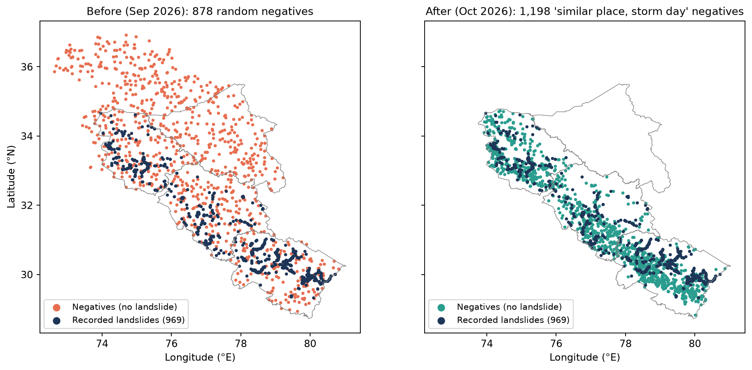
Why the old 'no-landslide' examples were wrong
METHOD: NEGATIVE EXAMPLES
Random negatives sat on high, icy, remote ground, so a model could score well without learning anything about rain
3,868 m
median height of old negatives (landslides: 1,228 m)
408 of 878
old negatives above 4,000 m: snow, glaciers, bare rock
4.8 km
median distance to a road (landslides: 22 m)
Blue: recorded landslides. Left: old random negatives. Right: new 'similar place, storm day' negatives.
Source: Our analysis of the 878 background points used in Presentation 2 and of the new negatives (elevation: Copernicus DEM; roads: OpenStreetMap).
Notes:
Median elevation rechecked (3,866 m, 406 above 4,000 m). The median road distance of 4.8 km is over all points; counting only the 755 inside our road layers it is 2.6 km.

Slide 11
New design: two kinds of 'hard' negatives
METHOD: NEGATIVE EXAMPLES
One kind teaches WHEN (same place, safe day), the other teaches WHERE (similar slope, storm day)
Type 1: same place, safe day (969)
Type 2: similar place, storm day (1,198)
Exactly the landslide's location, on a different day
No recorded slide within 5 km and 30 days of that day
Months follow the landslides' mix (88% June–September), so many safe days are rainy too
Only the weather differs, so this measures how well the model reads rain
A random spot in the same state on the landslide's date
Slope at least 10.9° and within 284 m of a motorable road (like 90% of our slides)
At least 2 km from any recorded slide; at most 10 per storm day
The storm is shared, so this teaches which ground fails
Median rain (IMERG, mm) | On the day | 7 days before | 30 days before
Recorded landslides | 34 | 89 | 217
Type 1: same place, safe day | 1.5 | 30 | 145
Type 2: similar place, storm day | 8 | 65 | 269
Training table: 969 landslides + 2,167 negatives = 3,136 rows. All rules re-checked: 0 violations.
Source: Steger et al. 2024, Geoscience Frontiers 15(3):101822; Zhu et al. 2024, Geomatics, Natural Hazards and Risk 15(1); thresholds from our own landslide data.
Notes:
10.9 degrees and 284 m are the 10th and 90th percentiles of our own landslides; 5 km, 30 days and 2 km are judgement values. Fixed random seed 20261022.

Slide 12
Honest testing: hide whole years, not random rows
METHOD: TESTING
Rows from the same storm share weather; testing on random rows lets the model 'see' the storm it is scored on
How it works (simplified):
2010
2011
2013
2015
2016
2023
2025
Grey years: train the model. Orange year: scored by that model, which never saw any storm of that year. Repeat until every year has been scored once; then compute one score over all rows.
What the chart shows
Same model, three ways of testing
Random rows: 0.856 (live) and 0.880 (full model)
Whole years hidden: 0.775 and 0.801, the numbers we report
The gap (about 0.08) is the optimism of the easy test
Source: Roberts et al. 2017, Ecography 40(8):913–929; Brenning 2005, NHESS 5:853–862; our cross-validation results (whole years held out).
Notes:
Year-blocked 5-fold cross-validation: every row is scored by a model that never saw its year. Same Random Forest recipes in all three tests; nothing was chosen from this comparison.

Slide 13
Three model types, compared fairly
METHOD: MODEL CHOICE
XGBoost scored highest but leaned on roads instead of rain; we chose Random Forest
Model (38 features, whole years hidden) | ROC AUC, all | ROC AUC, HP | Without road features | Weather-only test | Verdict
Logistic regression | 0.780 | 0.753 | 0.762 | 0.744 | Baseline
Random Forest | 0.801 | 0.790 | 0.755 | 0.746 | Chosen
XGBoost | 0.807 | 0.804 | 0.737 | 0.722 | Clearly worse on weather-only test
The weather-only test
Why Random Forest
A daily warning lives or dies on reading the weather
Landslide days vs safe days at the same places: roads, rock and slope are identical, only the weather differs
The rule for 'clearly worse' was fixed before the test
Almost as good overall as XGBoost (0.801 vs 0.807)
Not worse than road-free models at reading the weather; XGBoost was
Fewer false alarms on HP safe days at the same catch rate
Source: Breiman 2001 (Random Forest); Chen and Guestrin 2016 (XGBoost); Stanley et al. 2021 (LHASA v2); our cross-validation results (whole years held out).
Notes:
Weather-only test: landslides vs same-place safe days, where road distance is identical. Rule fixed before running: 'clearly worse' if lower AUC and the 95% interval of the difference (2,000 resamples of whole years) lies entirely below zero. XGBoost with roads: -0.031 vs road-free logistic regression (interval -0.061 to -0.009) and -0.029 vs road-free Random Forest (-0.044 to -0.010).

Slide 14
The road bias in landslide records, and how we correct for it
METHOD: REPORTING BIAS
Slides are recorded where they hit roads; we keep road distance in training but score every cell as if it were watched like a roadside slope
22 m
Live model; same safe-day false alarms (16%) | Real road distances | Road-neutral
All recorded slides caught | 37% | 49%
Remote slides caught (> 500 m from road) | 29% | 36%
Weather-only test (ROC AUC) | 0.683 | 0.741
Other slopes flagged on storm days | 3% | 18%
median distance of a recorded landslide to a road
1st / 2nd
rank of 'distance to major road' among 38 features in every model
70 (9 in HP)
Decision and its cost
Road-neutral scores drive the whole-HP map and the district alerts; real-road scores kept as a second layer
Gain: more slides caught, including remote ones, at the same false-alarm rate on safe days
Cost: on storm days much more of the map is flagged; remote false alarms cannot be measured
recorded slides more than 500 m from a road: few to test remote skill with
Source: Steger et al. 2017, Landslides 14:1767–1781; Steger et al. 2021, Sci. Total Environ. 776:145935; our cross-validation results (whole years held out).
Notes:
Road-neutral scoring sets both road distances to the training landslides' median at prediction time. Adding remote negatives was rejected: almost all landslides are near roads, so the model would learn 'remote = safe' through other features. Real-road scores are kept as a second map layer, 'where slides are likely to hit roads'.

Slide 15
Live model: only data available on the morning it runs
METHOD: LIVE DATA
Two rain and soil sources arrive weeks late, so the daily system uses a slightly weaker 'live' model
Data | Delay in Earth Engine | Usable every morning?
NASA GPM IMERG rain | about 2 days | Yes
NOAA GFS forecast rain | runs complete in 6–12 h | Yes (fills the last 2 days, today, tomorrow)
ERA5-Land soil moisture, snow | about 12 days | No
CHIRPS rain | about 24 days (monthly) | No
Whole years hidden | Full model (38) | Live model (28)
ROC AUC, all states | 0.801 | 0.775
ROC AUC, HP | 0.790 | 0.763
Weather-only test | 0.746 | 0.683
HP safe days flagged at Watch | 16% | 26%
HP safe days flagged at Warning | 5% | 13%
What this means
The full model is the best possible with complete data; the live model is what can actually run each day. We report both.
The cost of the delays: the same share of slides is caught, with more false alarms (26% vs 16% of safe days at Watch).
Rejected: putting IMERG values into the CHIRPS slots; in these mountains the two correlate only 0.53–0.75.
Source: Data delays checked in the Google Earth Engine catalogue (Oct 2026); our cross-validation results (whole years held out).
Notes:
GFS rain totals reset every 6 hours, so a day's forecast is the sum of the four 6-hour totals (tested at three wet locations). Training always uses observed rain only; forecast rain is used only in the live run for the most recent days.

Slide 16
Two alert levels, set provisionally
METHOD: ALERT LEVELS
Watch and Warning trade missed slides against false alarms; final values will be set from storm replays with rules fixed in advance
Level (HP, chosen model) | Score | HP slides caught | HP safe days flagged | About false alarms per month at one spot
Watch: be ready | ≥ 0.35 | 55% | 16% | 4.8
Warning: act | ≥ 0.45 | 33% | 5% | 1.5
Why provisional
Rules for the replays, written before running them
Levels are set per 1 km cell, but alerts go out per district
The district rule (now: a district is alerted when 5% of its cells are) proved far too loose on the storm day
Both are fixed together after replaying several storms and quiet periods
Hit: the district is at Watch or higher on the event day or the day before
Quiet days: count alert days on monsoon days with no recorded slide
Each storm scored by a model that never saw its year
Context: NASA's LHASA detected 8–60% of catalogued landslides
Source: NASA GES DISC, Global Landslide Nowcast (LHASA) README; Kirschbaum and Stanley 2018, Earth's Future 6:505–523; our cross-validation results (whole years held out).
Notes:
'False alarms per month at one spot' = safe-day false-alarm rate x 30 (a proxy for a landslide-prone spot, mostly monsoon months); real district counts come from the replays. Replay criteria written on 24 Oct, before any replay.

Slide 17
Our three research questions: where they stand
RESULTS: RESEARCH QUESTIONS
RQ1 is answered: rainfall is what makes daily timing possible, and adds a little to locating slides; RQ2 and RQ3 are not started
Research question (Presentation 1) | Status | Answer so far
RQ1: Does past and forecast rain improve prediction beyond terrain alone? | Answered (past rain) | WHEN a slide happens can only come from rain (terrain is the same every day). For WHERE on a storm day, rain adds a little on top of terrain (chart). Forecast rain: live system only, to be measured in the replays
RQ2: Can activity records tell new slides from reactivated ones? | Not started | Needs the inventory's free-text movement and activity fields cleaned first
RQ3: Which terrain, land-use change and rain combinations go with persistent movement? | Not started | Land-cover change needs more than the two WorldCover years (2020, 2021) available
Source: Research questions as set in our Presentation 1; our cross-validation results (whole years held out).
Notes:
Fair RQ1 test: landslides vs other slopes on the same storm days, trained without the same-place twins, whole years hidden. A first run on all rows gave a terrain-only score below 0.5 because each landslide's same-place twin (identical terrain, opposite label) is in training when it is tested; it was not a fair test and is recorded as such. The terrain score includes road distance, so it carries the reporting bias of slide 14.

Slide 18
Does the model beat a simple rain rule?
RESULTS: BASELINE
Rain alone tells WHEN a slide happens about as well as any model; the model adds WHERE
What we learn
WHEN: rain on the day alone (0.805) is as good as or better than every model
WHERE + WHEN: every model beats rain alone (up to 0.79 vs 0.68)
Why: half our negatives are other slopes on the same storm days, as wet as the slides, so one model learns to weigh rain less
No model can time slides better than its rain input; satellite rain pixels are about 10 km wide
Source: IMD national bulletins (heavy rain: 64.5–115.5 mm per day); our cross-validation results (whole years held out).
Notes:
Rule family: 'rain on the day >= threshold' (IMERG, local Indian day). Two tests on HP rows: WHEN = landslides vs same-place safe days; WHERE + WHEN = landslides vs all negatives. Diagnosis: the live model trained only on landslides vs safe days reaches timing 0.802 in HP, equal to rain alone; mixing in storm-day negatives, which are as wet as the slides, made the single model weigh rain less.

Slide 19
A two-part model: WHERE × WHEN
RESULTS: MODEL STRUCTURE
Splitting the questions, as NASA's LHASA does, improves the overall score and halves wrong flags on other slopes
WHERE
Which slopes fail?
Landslides vs other slopes on the same storm day; terrain, rock, roads, vegetation
WHEN
Which days are dangerous?
Landslides vs safe days at the same place; rain only
Live data, whole years hidden | Single model | Two-part model
ROC AUC, all states | 0.775 | 0.813
ROC AUC, HP | 0.763 | 0.777
HP safe days flagged (55% caught) | 25.6% | 21.5%
Other slopes flagged on storm days | 13.9% | 7.4%
Timing (HP); rain alone 0.805 | 0.705 | 0.717
×
= daily risk score
Reading
Better overall and fewer wrong flags on other slopes: a real improvement, and a structure used by an operational system
Timing improves only slightly: the satellite rain data, not the algorithm, limits how well slides can be timed
Status: candidate for the final live model; to be confirmed in the storm replays
Source: Kirschbaum and Stanley 2018, Earth's Future 6:505–523; our cross-validation results (whole years held out).
Notes:
WHERE part: Random Forest, landslides vs other slopes on storm days, fixed features + NDVI + glacier flag (21). WHEN part: landslides vs same-place safe days, IMERG rain only (7), logistic regression on log rain. Two WHEN variants (Random Forest 0.793, logistic 0.813 overall) were compared on the same test folds, so the chosen variant's score is slightly optimistic. Candidate for the final live model; not yet adopted.

Slide 20
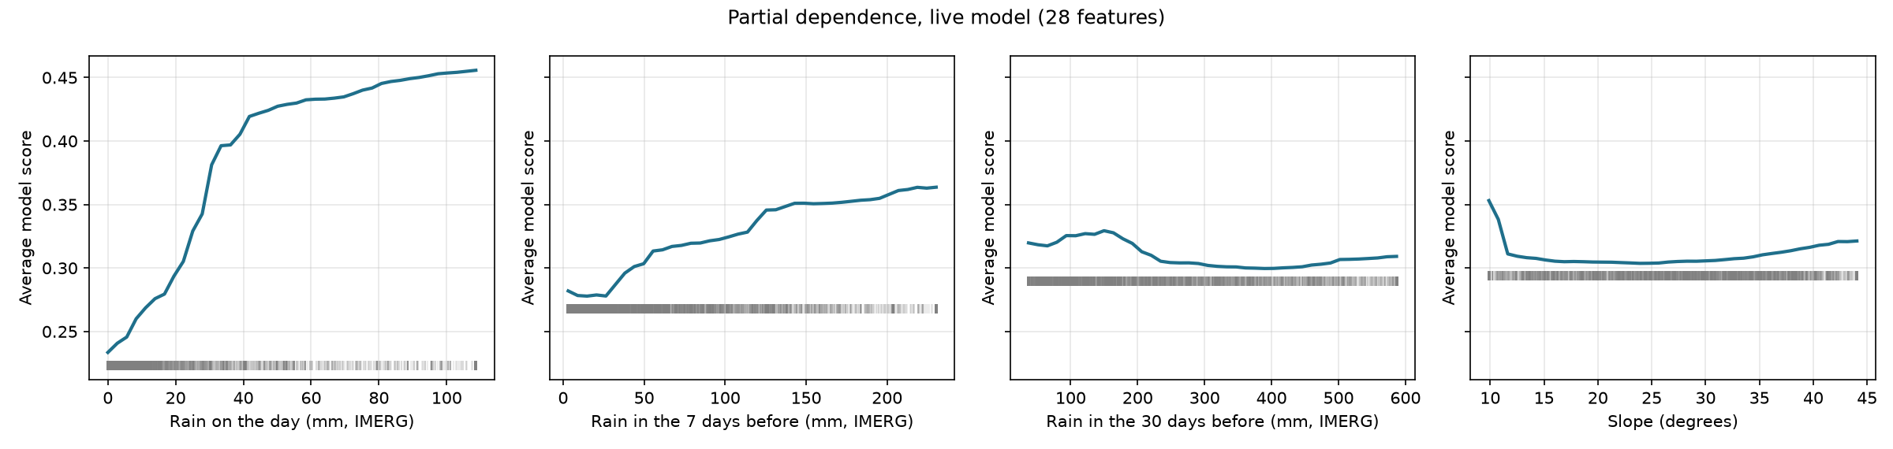
Physics check: what the model learned
RESULTS: PHYSICS CHECK
Rain effects look physical; two odd curves trace back to how the negatives were sampled
Rain on the day
Rain in the 7 days before
Rain in the 30 days before
Slope
Score doubles (0.23 to 0.46), steepest between 10 and 40 mm, then levels off
Steady rise (0.28 to 0.36): wet ground fails more easily
Flat: storm-day negatives are just as wet over 30 days
Spike near 10° (negatives only drawn on slopes ≥ 10.9°); gentle rise above 30°
Physical
Physical
Sampling artefact
Partly artefact
Source: Our partial-dependence analysis of the live model.
Notes:
Partial dependence: the average score when one input is varied over its 5th-95th percentile range while the others keep their observed values. 30-day rain: storm-day negatives are as wet over 30 days as the landslides (median 269 vs 217 mm). Slope spike near 10 degrees: storm-day negatives were only drawn on slopes of at least 10.9 degrees. Both are reasons to revisit the negative design for the final version.

Slide 21
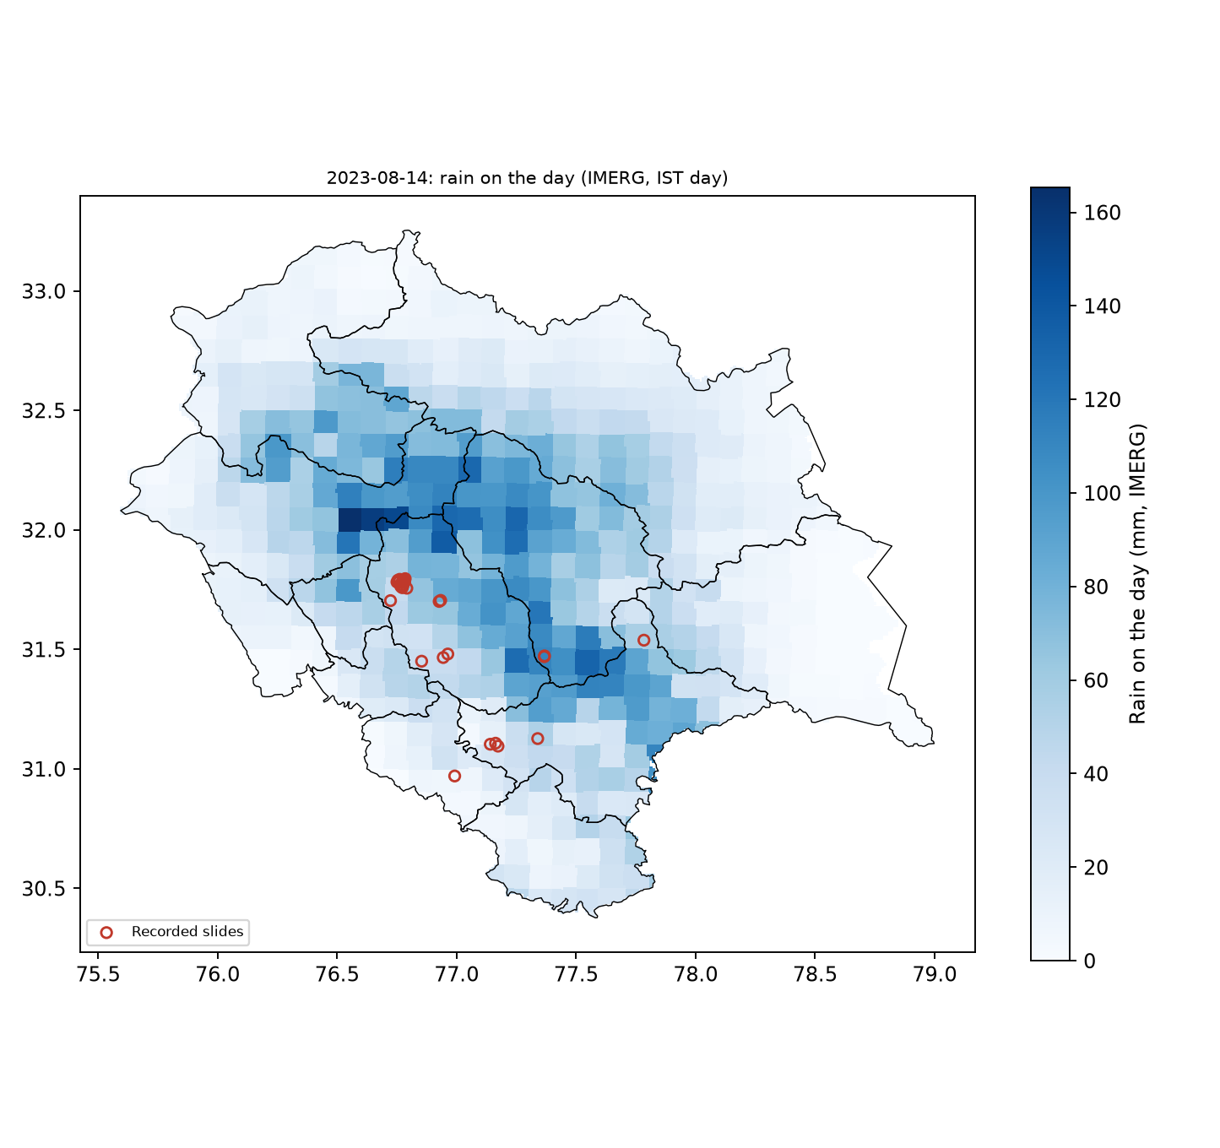
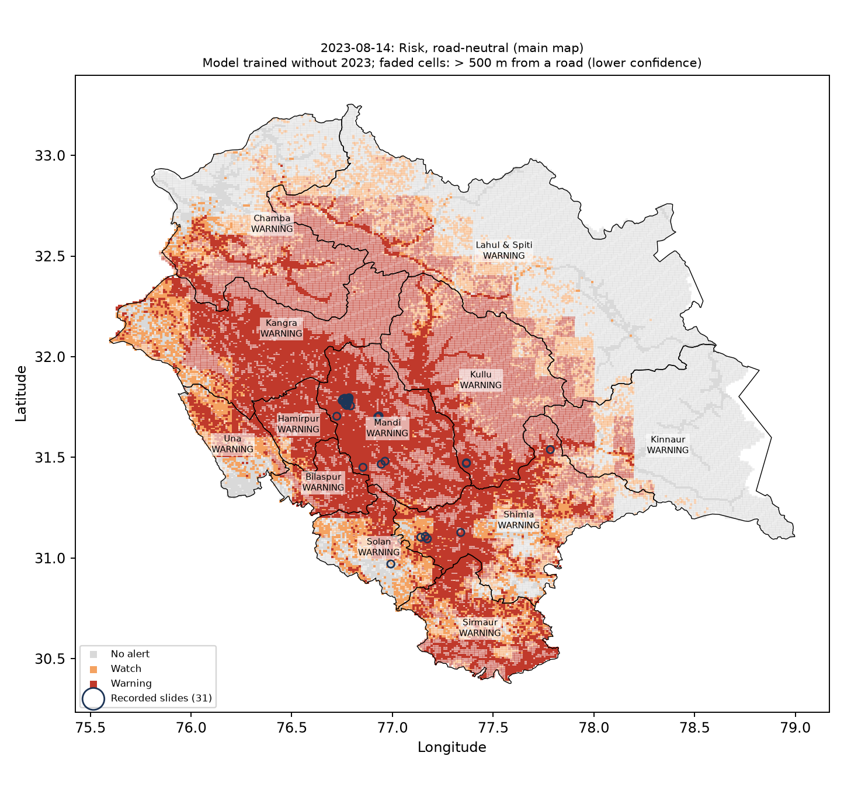
Whole-HP risk map for a real disaster day: 14 Aug 2023
RESULTS: WHOLE-HP MAP
With a model that never saw 2023, all 31 recorded slides fall in alert cells, but two-thirds of the state is flagged
31 of 31
recorded slides in Watch or Warning cells (29 at Warning)
66.8%
of HP's cells at Watch or above (47.2% at Warning)
12 of 12
districts at Warning under the provisional 5% rule: too loose
Left: rain on the day (IMERG). Right: risk levels; circles = recorded slides.
Source: Our model run on NASA GPM IMERG V07 rainfall for all HP cells (Google Earth Engine); recorded slides: GSI Bhusanket, NASA Global Landslide Catalog.
Notes:
Live model retrained without any 2023 rows; road-neutral scoring; levels matched to the live levels' HP safe-day false alarms (Watch 0.376, Warning 0.463). All 55,253 cells scored. Real-road layer: 10 of 31 slides in alert cells (grid-cell centres are often farther from a road than the slide itself). One day is an illustration, not a validation.

Slide 22
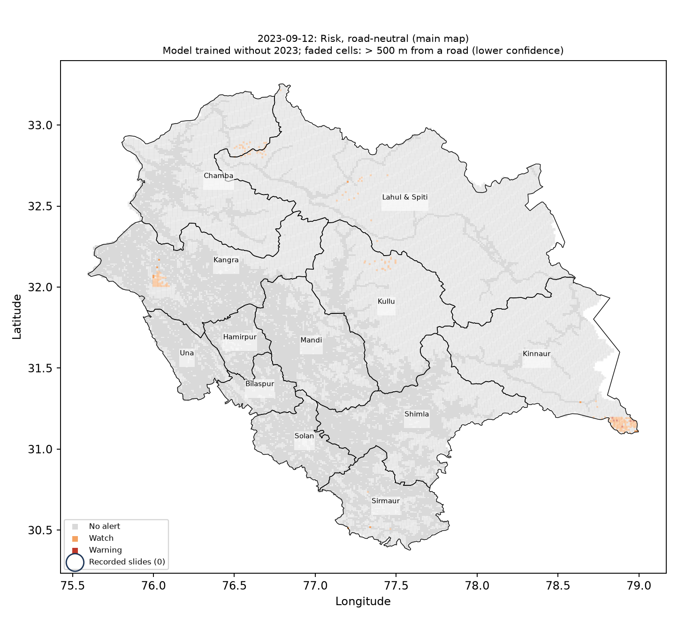
Storm day vs quiet day, same model and levels
RESULTS: WHOLE-HP MAP
The system lights up on the disaster day and stays calm on a quiet day; rainy days without slides are the next test
 | Storm day 14 Aug 2023 | Quiet day 12 Sep 2023
HP mean rain on the day | 40.3 mm | 0.8 mm
HP at Watch or above | 66.8% | 0.4%
HP at Warning | 47.2% | 0.0%
Districts alerted (of 12) | 12 | 0
Recorded slides in alert cells | 31 of 31 | none recorded
Caveat, stated plainly
Storm day, 14 Aug 2023
66.8% of HP at Watch or above
Quiet day, 12 Sep 2023
0.4% of HP at Watch or above
The quiet day was also nearly dry, so it shows only that the system stays calm without rain
The harder test, rainy days with no slides, comes from the storm replays (next phase)
Grey: no alert · orange: Watch · red: Warning · circles: recorded slides.
Source: Our model runs for 14 Aug and 12 Sep 2023 on NASA GPM IMERG V07 rainfall (Google Earth Engine); recorded slides: GSI Bhusanket, NASA Global Landslide Catalog.
Notes:
Quiet day 12 Sep 2023: no recorded HP slide within 10 days and none in the three states within 3 days. Same model trained without 2023 and same levels as the storm day. The two-part model gives the same picture (quiet day: 0.2% of HP at Watch, 0 districts).

Slide 23
Where we stand against the original goal
RESULTS: STATUS
Coverage and honesty are on track; accuracy is moderate and limited by the data; automation is the main work left
Original goal | Current status | Verdict
Whole of Himachal Pradesh | All 55,253 cells of 1 km scored; cells > 500 m from a road marked 'lower confidence' | On track
As accurate as the data allow | Live model AUC 0.775 (strict test); two-part 0.813. Rain timing capped by satellite rain; records biased to roads | Moderate; limits measured and explained
Daily warning to authorities | Daily scoring tested on two real days; district rule provisional; automation and email not built yet | Main remaining work
Research questions | RQ1 answered for past rain; RQ2 and RQ3 not started | Partly
Honest evaluation | Whole years hidden; rain-rule baseline; every experiment logged, including dropped and wrong ones | Achieved
Free tools only | Google Earth Engine, open data, Python | Achieved
Source: Results on slides 12–22 of this deck.
Notes:
Goal from the start: predict rainfall-triggered landslides for the whole of HP, as accurately as the data allow, delivered daily to authorities, with free tools. Three model types land within 0.03 AUC of each other, which points to data limits rather than the method.

Slide 24
Limitations
LIMITATIONS
We state each limit together with what it means for using the system
Records follow roads
Slides are recorded where they hit roads (median 22 m). Skill is measured mostly near roads; remote skill rests on 70 slides (9 in HP).
Timing capped by rain data
Satellite rain pixels are about 10 km; cloudbursts can be smaller. Rain alone times slides as well as our models.
Many slides missed
About 45% of HP slides at Watch and two-thirds at Warning (published nowcasts: 8–60% detected).
False alarms
Live model: about 1 in 4 safe days at a landslide spot reaches Watch; storm days flag large areas.
Small, clustered sample
195 HP slides; 242 of 981 events on one day (2013). HP numbers can move by several points.
Unrecorded slides as negatives
'No slide recorded' is not 'no slide happened'; buffers reduce but cannot remove this.
Sampling artefacts
30-day rain and gentle slopes are distorted by the negative design; to revisit.
Live data
The live model is weaker than the full model; forecast rain adds errors not yet measured.
Source: Our analyses on slides 10–22; Kirschbaum and Stanley 2018 (LHASA detection range).
Notes:
Scores are relative, not daily probabilities: training has about 1 landslide per 2.2 negatives, far more than in reality.

Slide 25
Mistakes we found and corrected
LIMITATIONS
Our own checks caught 14 mistakes (the main ones below); each was fixed and recorded, including one in Presentation 2
Mistake | How we found it | Correction
Presentation 2 said the 878 background points were inside HP with a 500 m buffer | Mapping the actual file | They spread over three states and beyond; stated on slides 6 and 10
Date coverage inflated (any text counted as a date) | Re-audit with a day-level parser | HP dated records: 10.4% → 1.7%
Some event dates wrong; 'trigger-consistency' claim built on them | October inventory audit | 981 cleaned events; claim dropped
Random negatives too easy; score inflated (0.895) | Instructor feedback; strict-vs-easy test | Hard negatives; whole-year testing
Curvature signs wrong (Earth Engine kernel orientation) | Tests on artificial surfaces | Kernels corrected
Road-corridor limit shrank the whole-HP goal | Team review, 29 Oct | Reversed; remote cells marked lower confidence
First RQ1 test unfair (terrain-only score below 0.5) | Result made no physical sense | Rerun on storm-day slopes only (slide 17)
255 border cells dropped, then counted as a 13th district | Count checks on the maps | Fixed; levels for 12 real districts only
Why we list them
Each mistake was caught by a check we built in: re-audits, count checks, and tests against known answers
Every experiment, kept, dropped or found wrong (70+ entries), is recorded in the project files, so the results here can be traced and repeated
Source: Our own checks during the project; each change was recorded with its evidence.
Notes:
Every experiment, including dropped and wrong ones, is recorded in the experiments log (70+ entries).

Slide 26
Next steps to the final report
NEXT STEPS
Turn the tested pipeline into a running service, test it on many storms, and design how its impact would be assessed
1
Daily automation
Automatic morning run, district summary, email to authorities, map app
2
Storm replays
Several storms and quiet periods, each with a model that never saw that year; set final levels and district rule
3
Better training data
Decide on regenerating negatives (v2); adopt the two-part model if confirmed; test IMD gridded rain; score the AHP baseline on the same test
4
Impact assessment
Method, survey questions for disaster authorities and road department, alert feedback format, pilot plan
5
Road-blockage study
Optional: what free satellite data can and cannot show after a slide
6
Final paper
Methods, results, limitations, plus the impact-assessment section
Source: Final-report requirements from the instructor's mail.
Notes:
Impact assessment (final report): how warnings would be judged in use (lead time, hits and false alarms per district, actions taken), survey questions for district and state disaster authorities and the road department, a feedback format per alert, and a pilot plan suitable for a funding proposal.

Slide 27
References
REFERENCES
Every method choice above rests on one of these sources or on a data test documented in the project files
Breiman, L. (2001). Random forests. Machine Learning 45, 5–32.
Brenning, A. (2005). Spatial prediction models for landslide hazards. NHESS 5, 853–862.
Chen, T., Guestrin, C. (2016). XGBoost: a scalable tree boosting system. Proc. KDD, 785–794.
Froude, M., Petley, D. (2018). Global fatal landslide occurrence from 2004 to 2016. NHESS 18, 2161.
Kirschbaum, D.B., Stanley, T., Zhou, Y. (2015). Spatial and temporal analysis of a global landslide catalog. Geomorphology 249, 4–15.
Kirschbaum, D., Stanley, T. (2018). Satellite-based assessment of rainfall-triggered landslide hazard for situational awareness. Earth's Future 6, 505–523.
Meena, S.R., Mishra, B.K., Blaschke, T. (2019). Landslide susceptibility mapping of the Kullu Valley, Himachal Himalayas. Geosciences 9(4), 156.
Reichenbach, P. et al. (2018). A review of statistically-based landslide susceptibility models. Earth-Science Reviews 180, 60–91.
Roberts, D.R. et al. (2017). Cross-validation strategies for data with temporal, spatial, hierarchical, or phylogenetic structure. Ecography 40(8), 913–929.
Singh, M. et al. (2024). Landslide susceptibility evaluation in the Beas River Basin … AHP. Quaternary Science Advances 14, 100180.
Stanley, T. et al. (2021). Data-driven landslide nowcasting at the global scale. Frontiers in Earth Science 9, 640043.
Steger, S., Brenning, A., Bell, R., Glade, T. (2017). The influence of systematically incomplete shallow landslide inventories on statistical susceptibility models. Landslides 14, 1767–1781.
Steger, S. et al. (2021). Correlation does not imply geomorphic causation in data-driven landslide susceptibility modelling. Science of the Total Environment 776, 145935.
Steger, S. et al. (2024). Adopting the margin of stability for space–time landslide prediction. Geoscience Frontiers 15(3), 101822.
Zhu et al. (2024). Considering the effect of non-landslide sample selection on landslide susceptibility assessment. Geomatics, Natural Hazards and Risk 15(1).
Data: GSI Bhusanket inventory; NASA GPM IMERG V07; CHIRPS (Funk et al. 2015); ERA5-Land; Copernicus DEM; MERIT Hydro; ESA WorldCover; Landsat; GSI NGDR; OpenStreetMap; IMD national bulletins; NASA LHASA README.
Source: All references were checked against the publisher or an index during the project.
Notes:
All references were checked (authors, year, journal, volume/pages or DOI) during the project.

